Slide 1








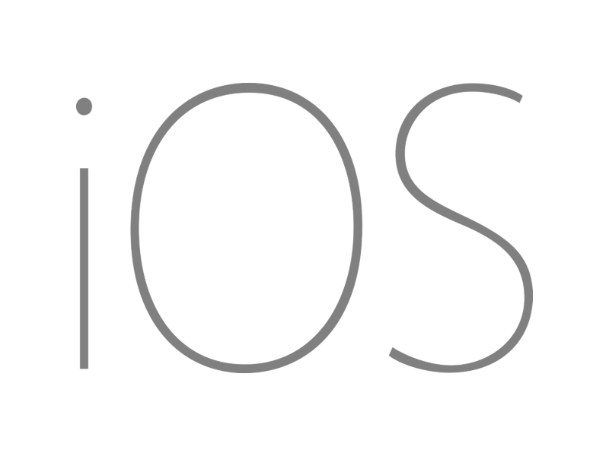

Slide 2


Slide 3
An open-source app platform
from Microsoft for building
modern, performant, & multi-platform
iOS, Android, macOS, & Windows apps
with C# and .NET from a
single shared codebase.

Slide 4

.NET MAUI App Architecture
C#
C#
C#
C#
Shared Code
UI, Resources, Platform Features, & Business Logic

Slide 5

Platform API Access
Sms
Secure Settings
Preferences
Flashlight
Clipboard
Gyroscope
Magnetometer
Geolocation
Phone Dialer
Device Display Info
Email
Device Info
Battery
Compass
Accelerometer
Screen Lock
Data Transfer
Text to Speech
Geocoding
File System
Connectivity
Vibration

Slide 6
Full App Platform
✓ 40+ Pages, layouts, and controls
(Build from C# or XAML)
✓ Two-way data binding
✓ Navigation
✓ Visual State Manager
✓ Animation API
✓ Dependency Service
✓ Messaging Center
✓ CI/CD Support
✓ Hybrid Development with Blazor
✓ Platform API Access
✓ Images, Icons, Fonts, Splash Screens
✓ Custom & Default Themes
C#
C#
C#
C#
Shared Code
UI, Resources, Platform Features, & Business Logic

Slide 7


UIActivityIndicator
ProgressBar
UISlider
SeekBar
ActivityIndicator
Slider

